Slide 1
Simatic S7-plc OPC Hardware Configuration Guide
Pre Requisites:
Simatic s7 plc.
Tia portal v15.
Simatic Net.
Note: Before proceeding with this guide, make sure that Simatic Net is installed along with tia portal

Slide 2
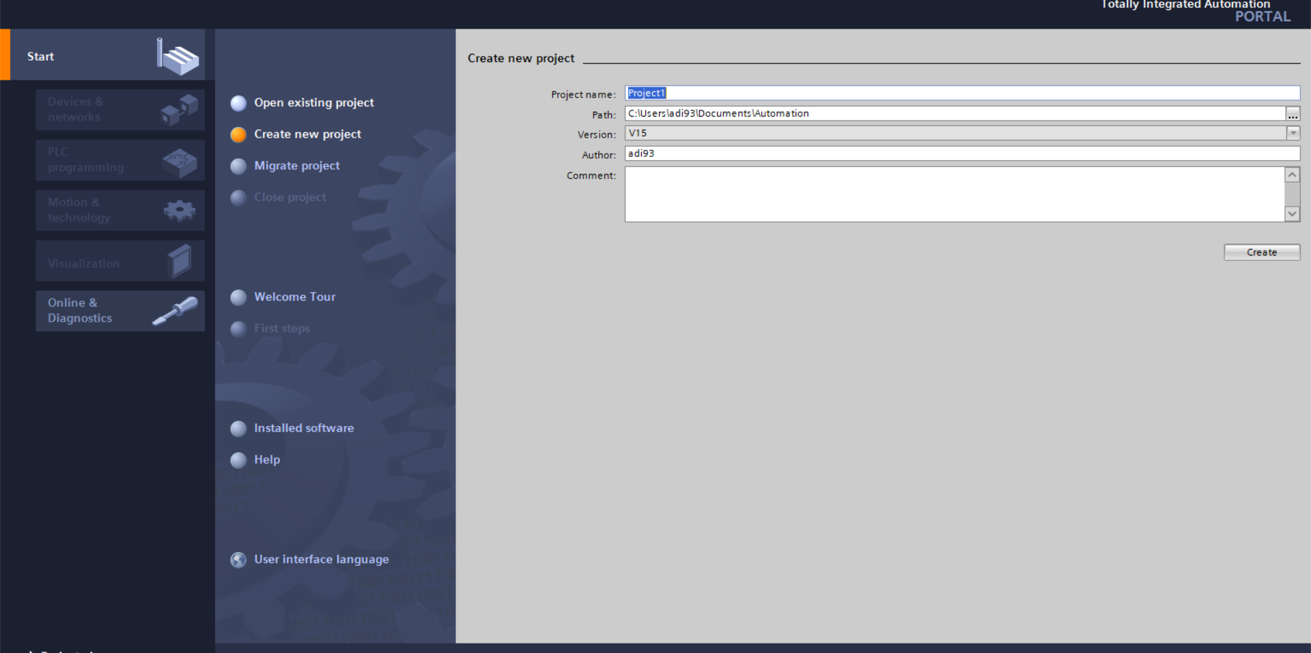
Create a new project with a name of your Choice

Slide 3
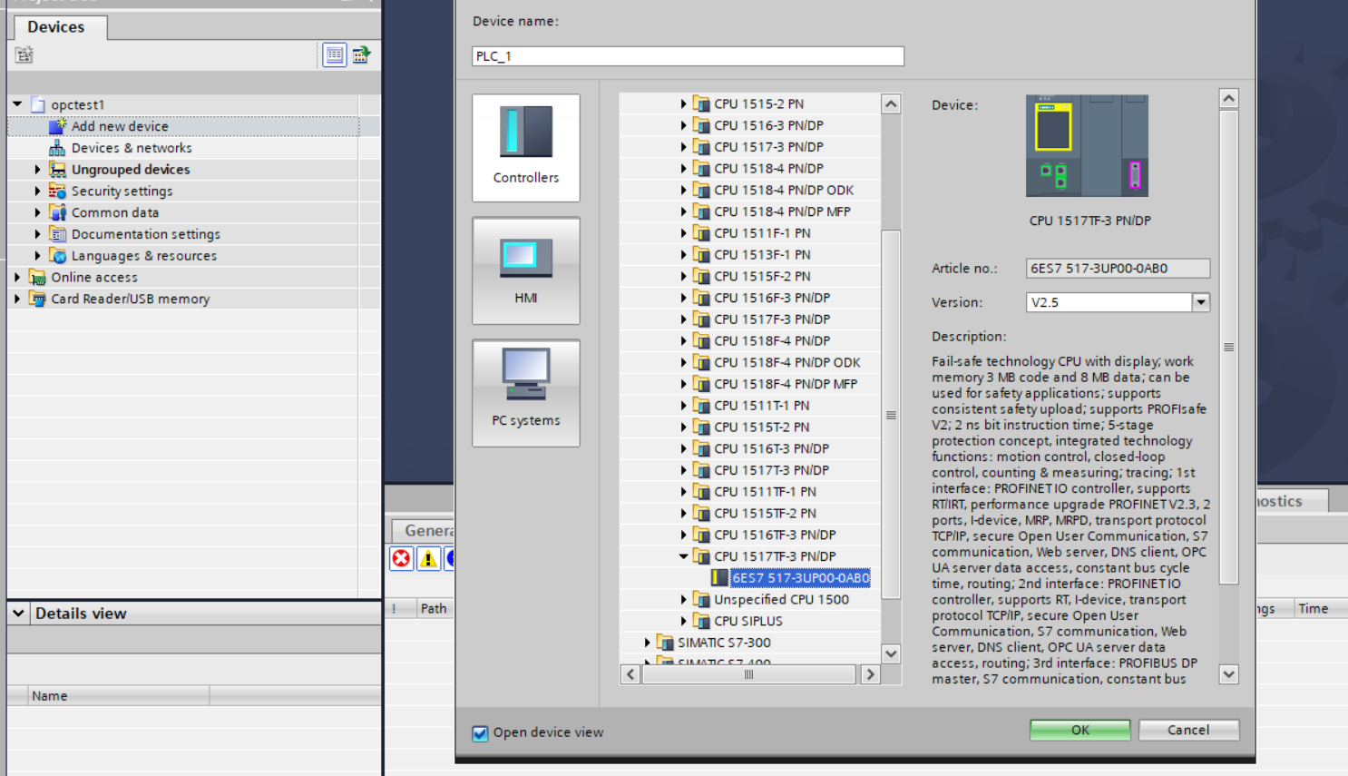
Add a new PLC/Controller

Slide 4
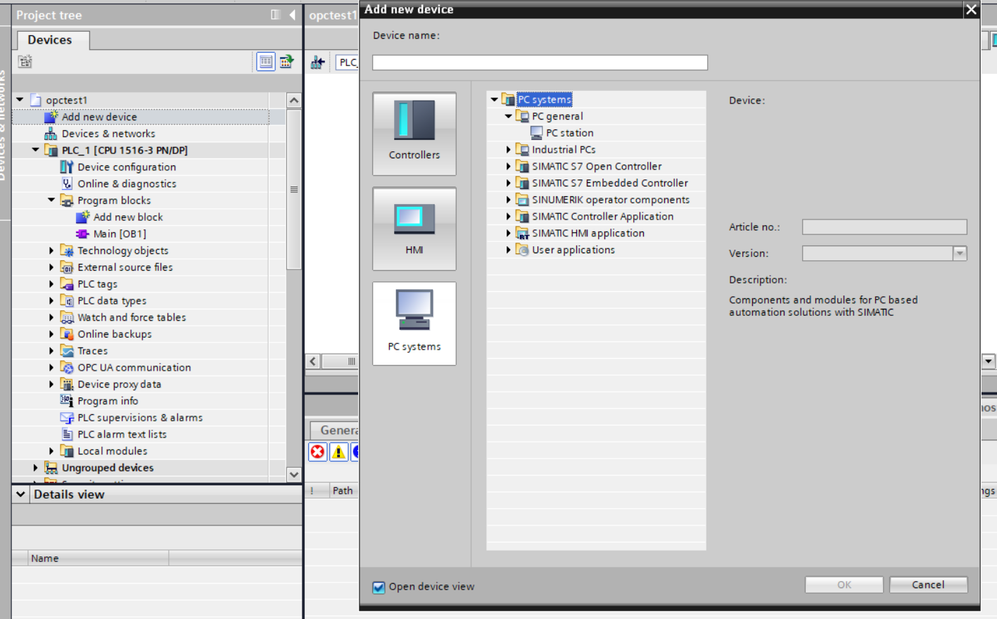
From PC Systems add a new PC Station

Slide 5
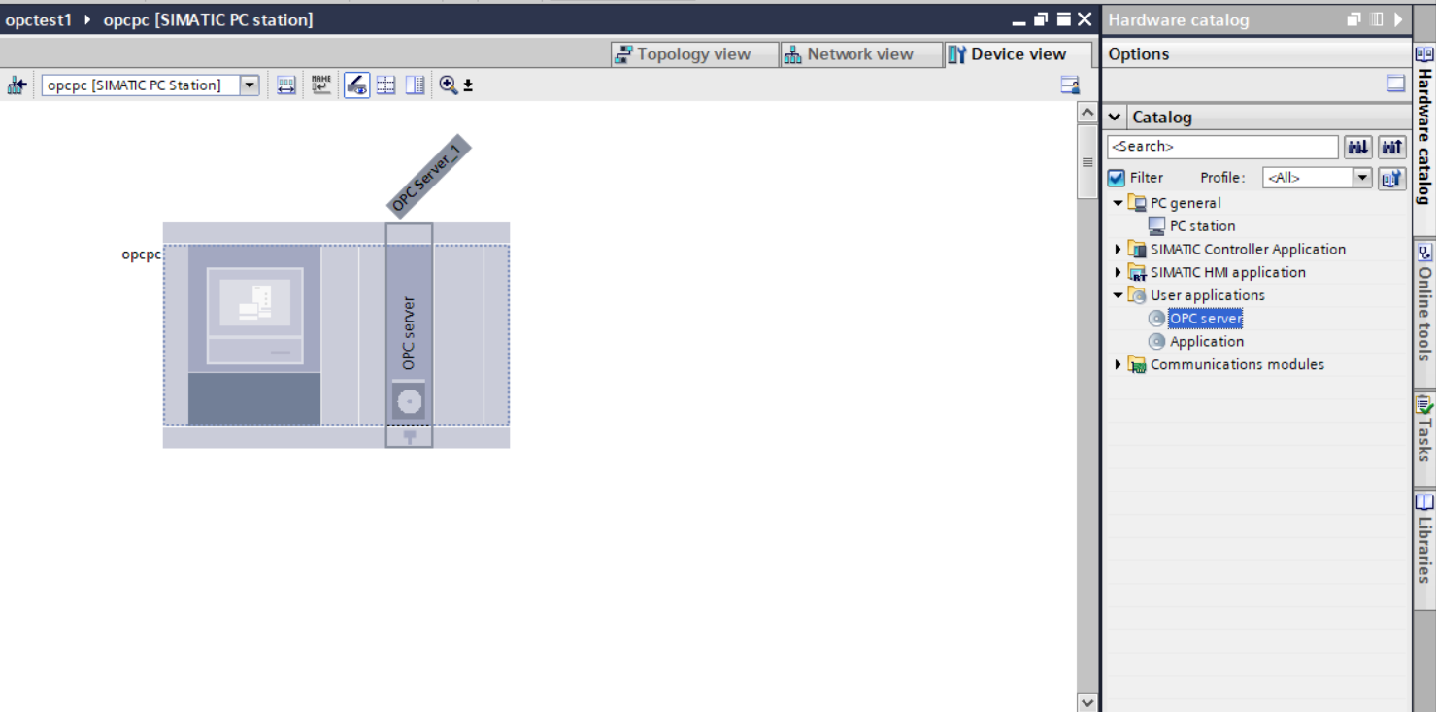
Double click on PC which should take you to Device view tab. In Device view, under user application select OPC SERVER and double click on it to add it to pc

Slide 6
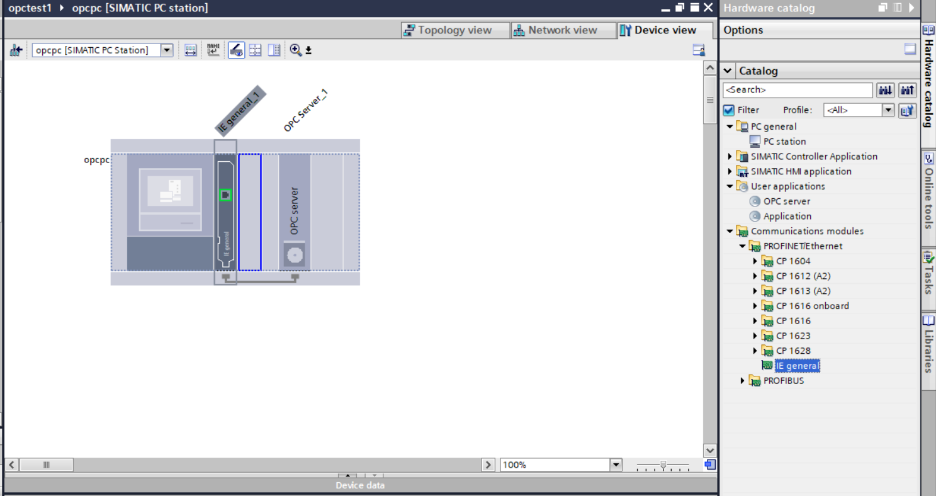
After adding OPC Server, add a communication module named ‘IE GENERAL’

Slide 7
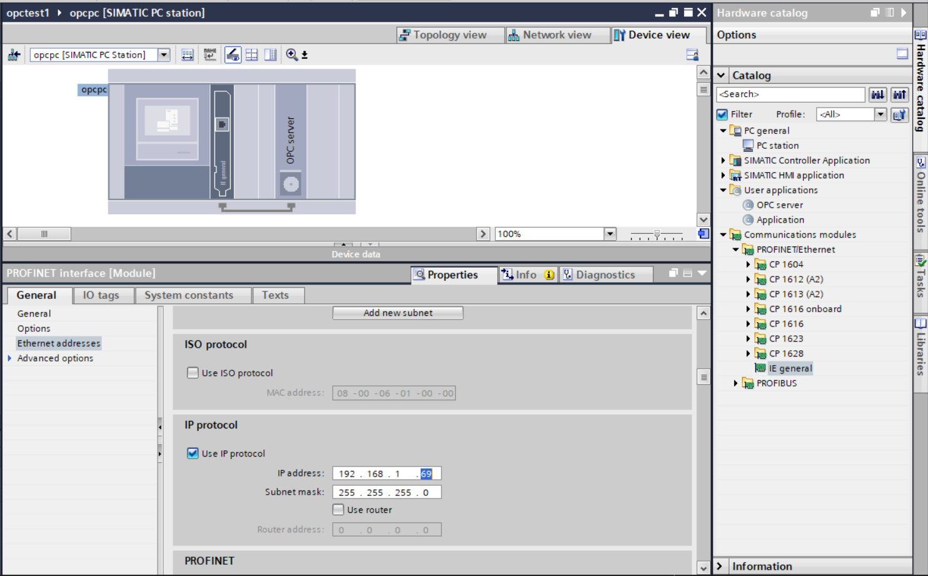
Click on the IE general card and specify the ip address of the PC where the OPC server would be running

Slide 8
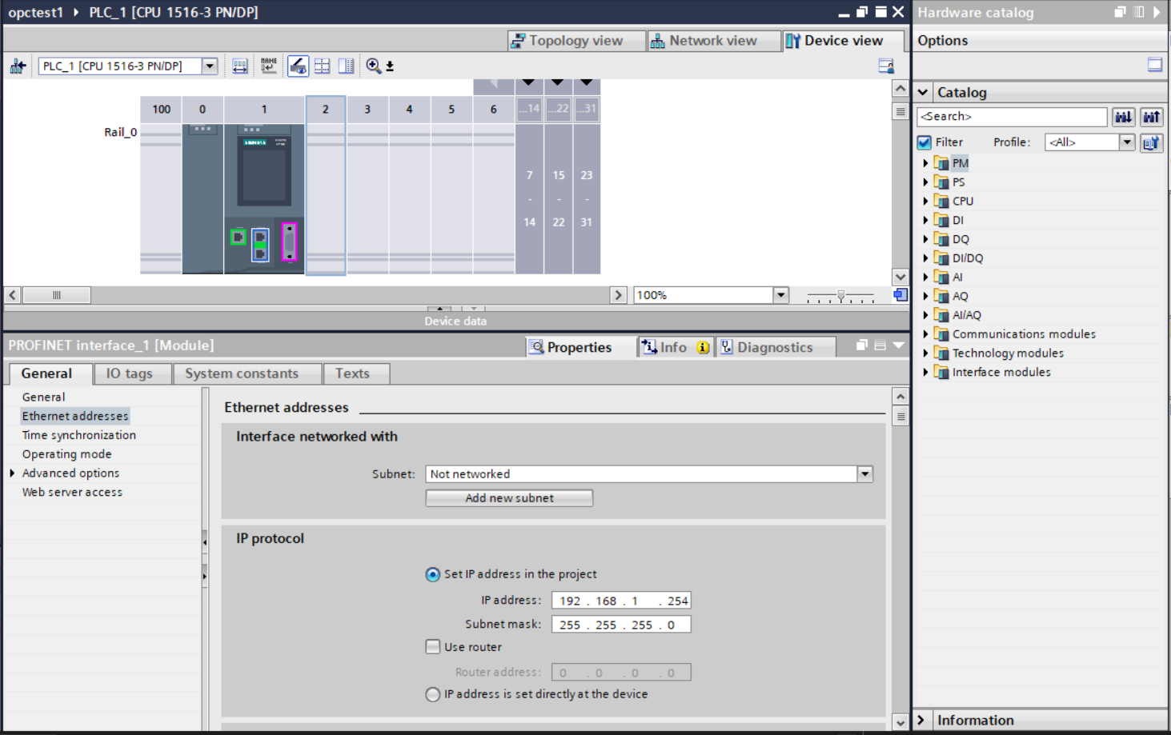
In network view, Double click on plc which should take you to device view section
Set a ip address to the plc.

Slide 9
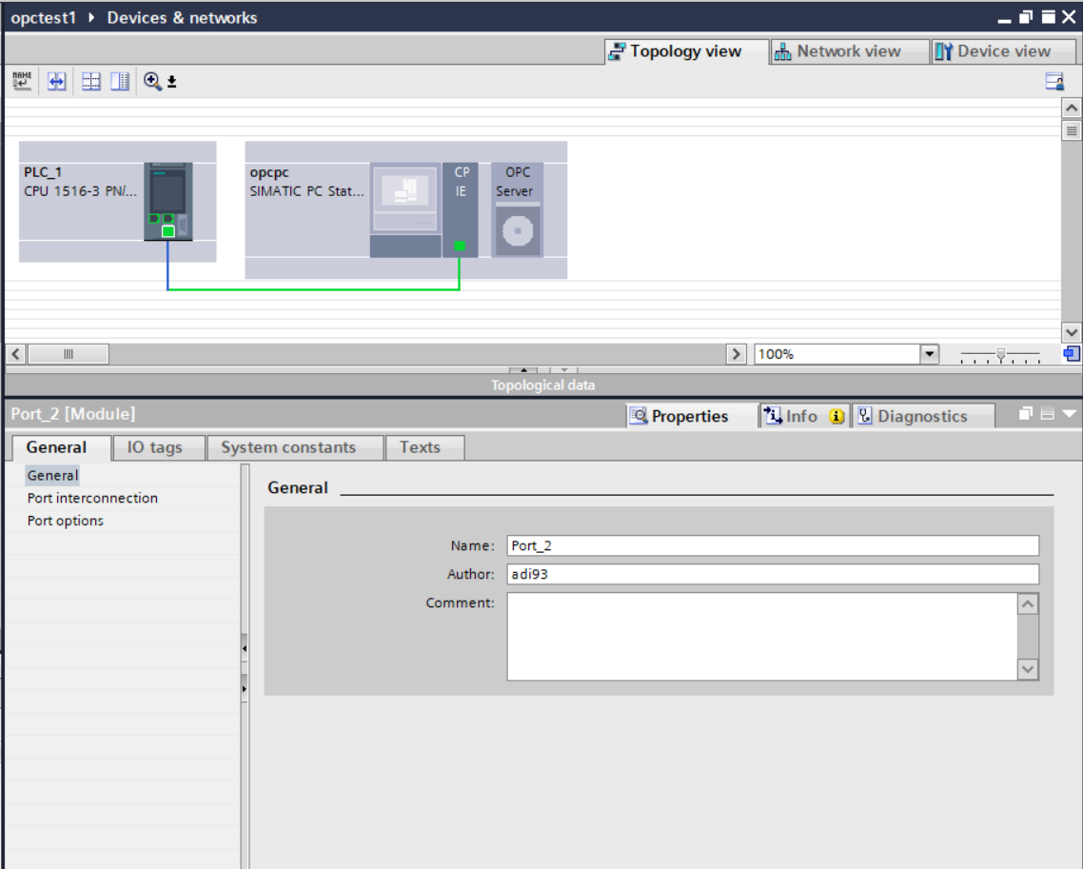
In Topology View, Establish connection between PLC and PC

Slide 10
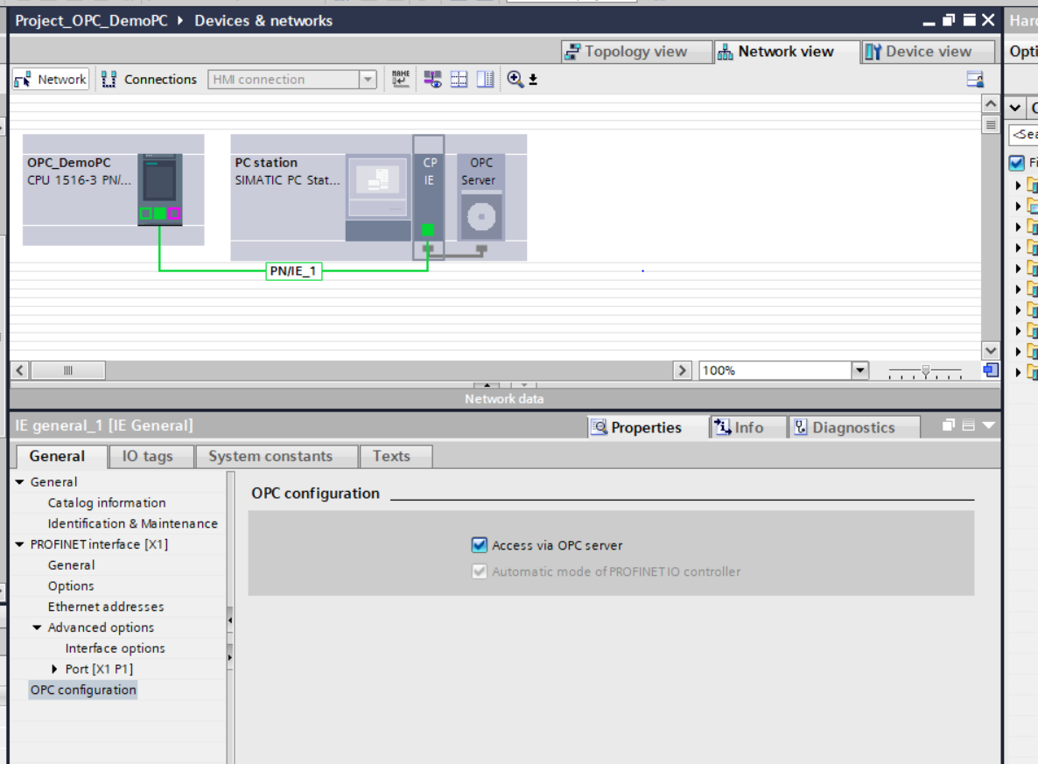
In Network View open CP IE properties and make sure that “Access via OPC server” is checked

Slide 11
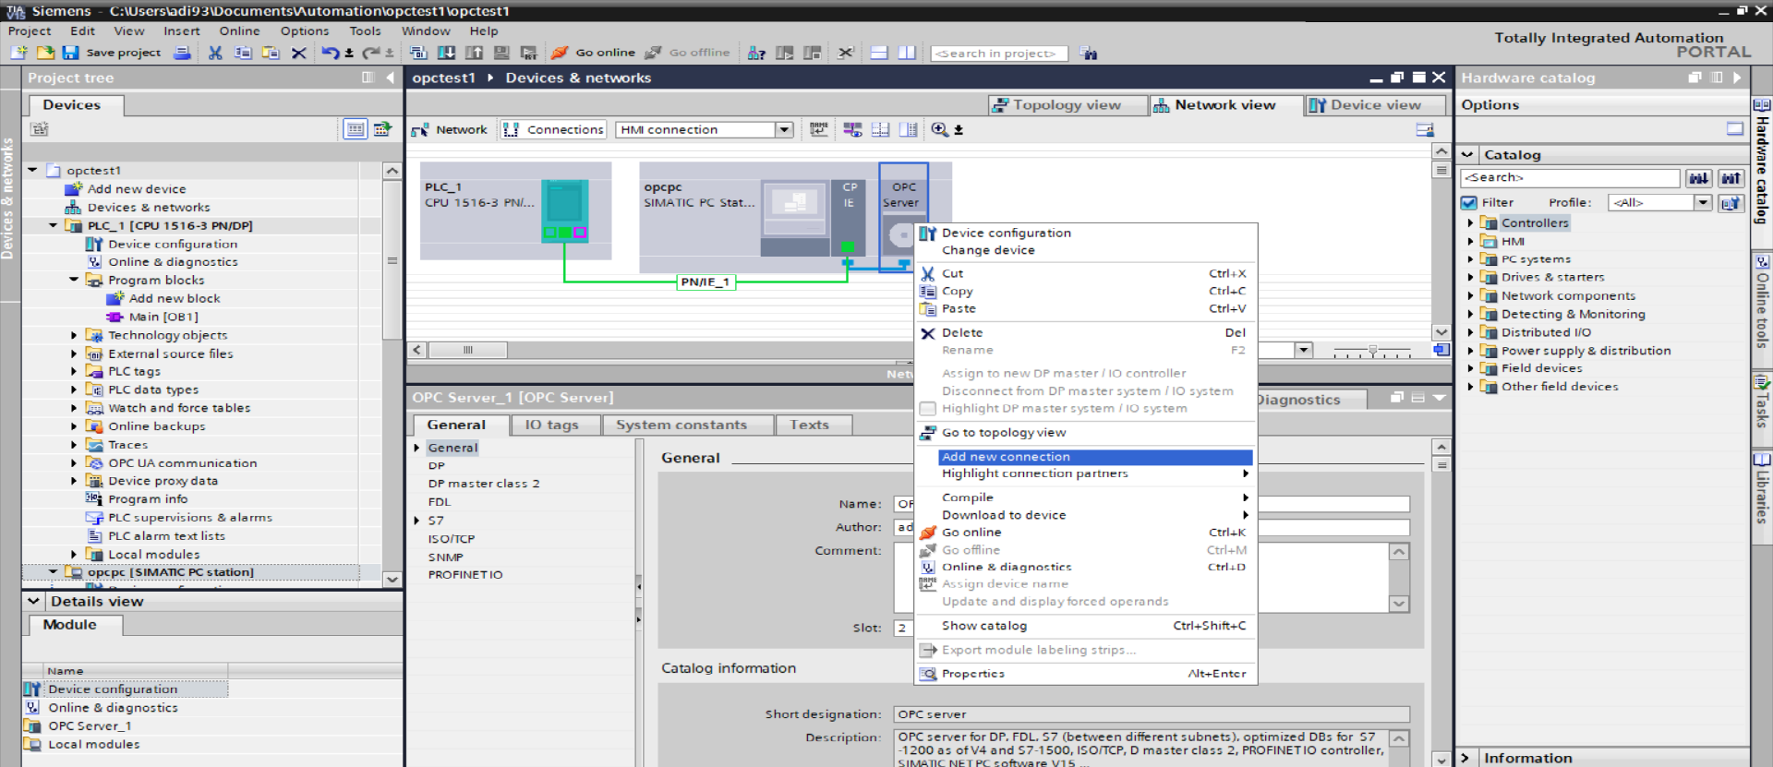
In Network View click on connections and right click on opc server and select add new connection

Slide 12
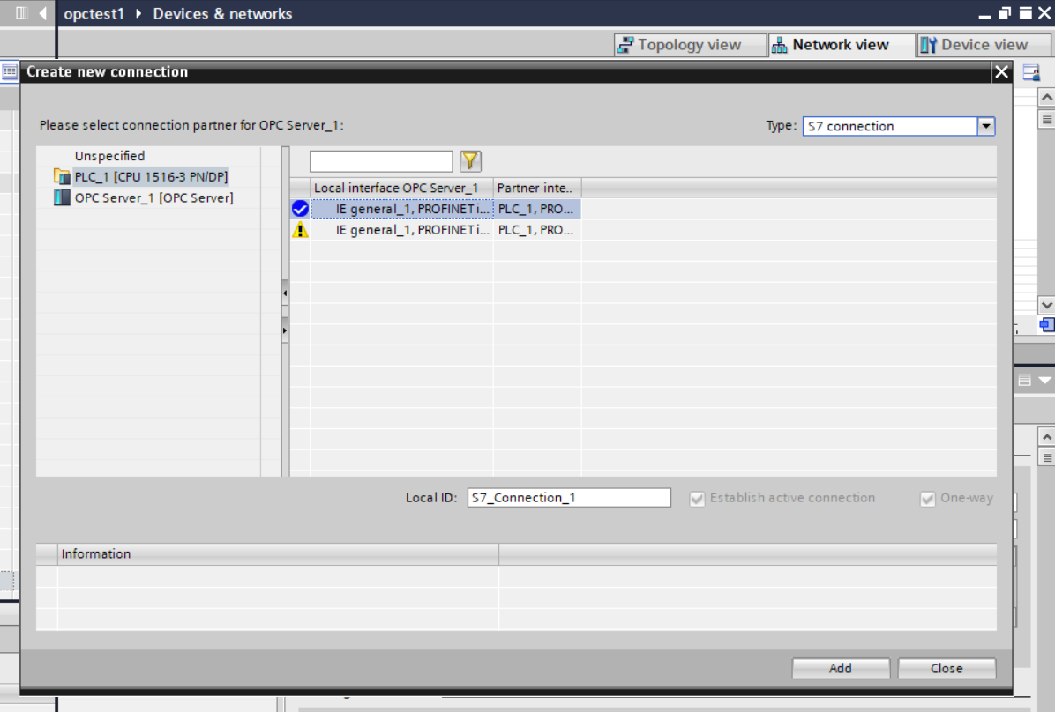
Select connection type as “S7 connection”
Click on the PLC on the left and select the connection and click add

Slide 13
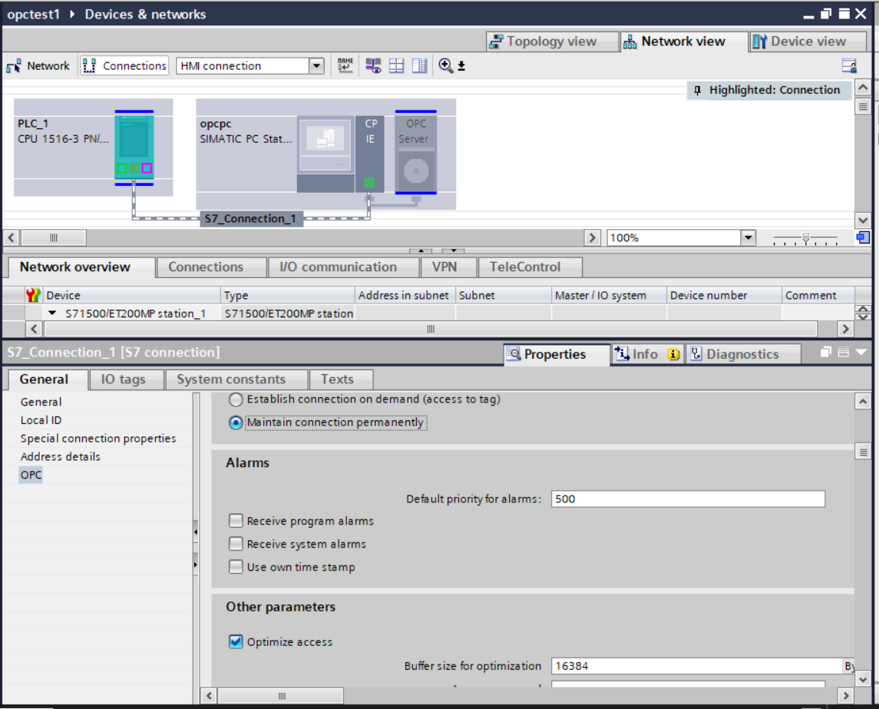
After adding the connection, click on the s7_connection and under opc section, select “Maintain connection Permanently”.

Slide 14
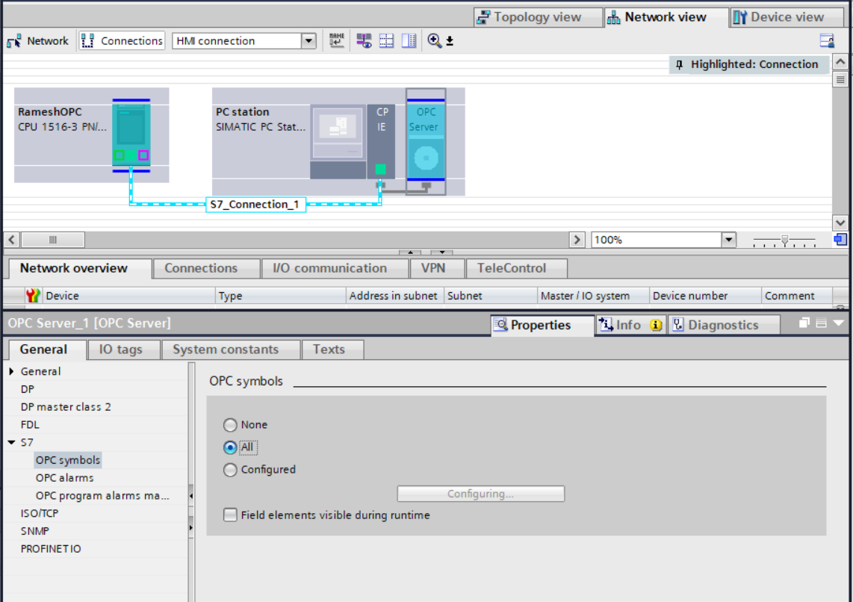
Click on opc Server and select OPC symbols under S7 tab and select ALL

Slide 15
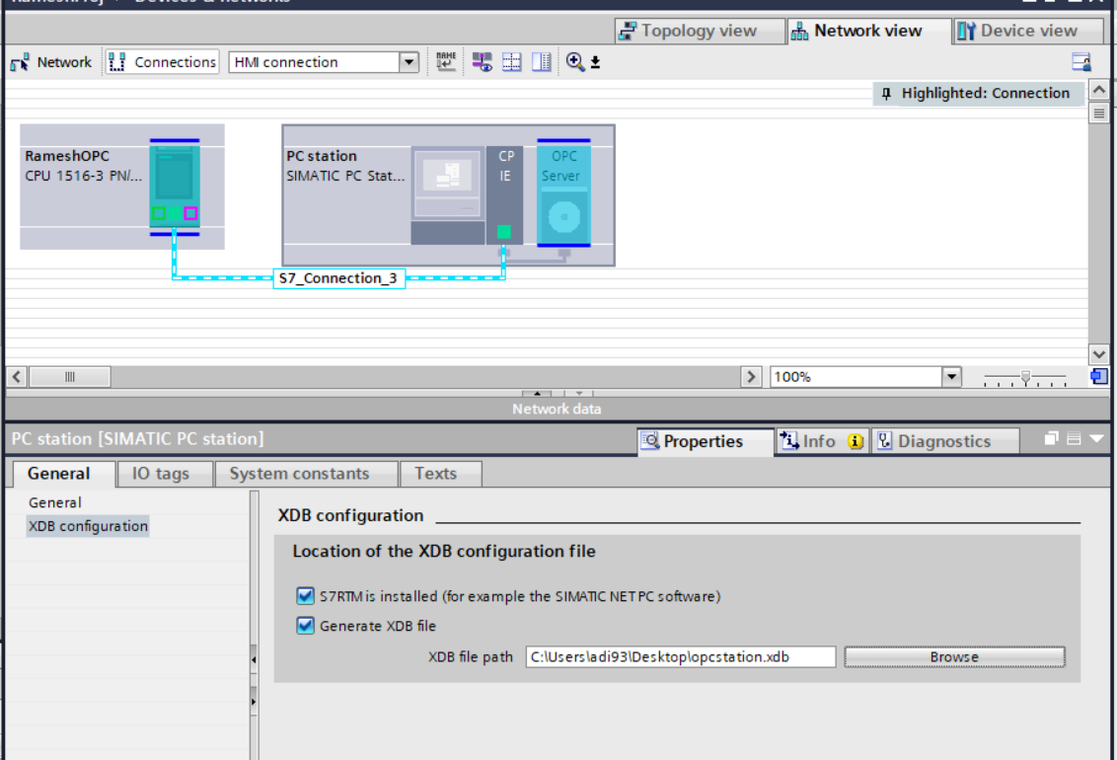
In PC properties check “Generate XDB file” and select a path to save the XDB file

Slide 16
In PC properties check “Generate XDB file” and select a path to save the XDB file

Slide 17
After all these configurations are done, download the program to PLC

Slide 18
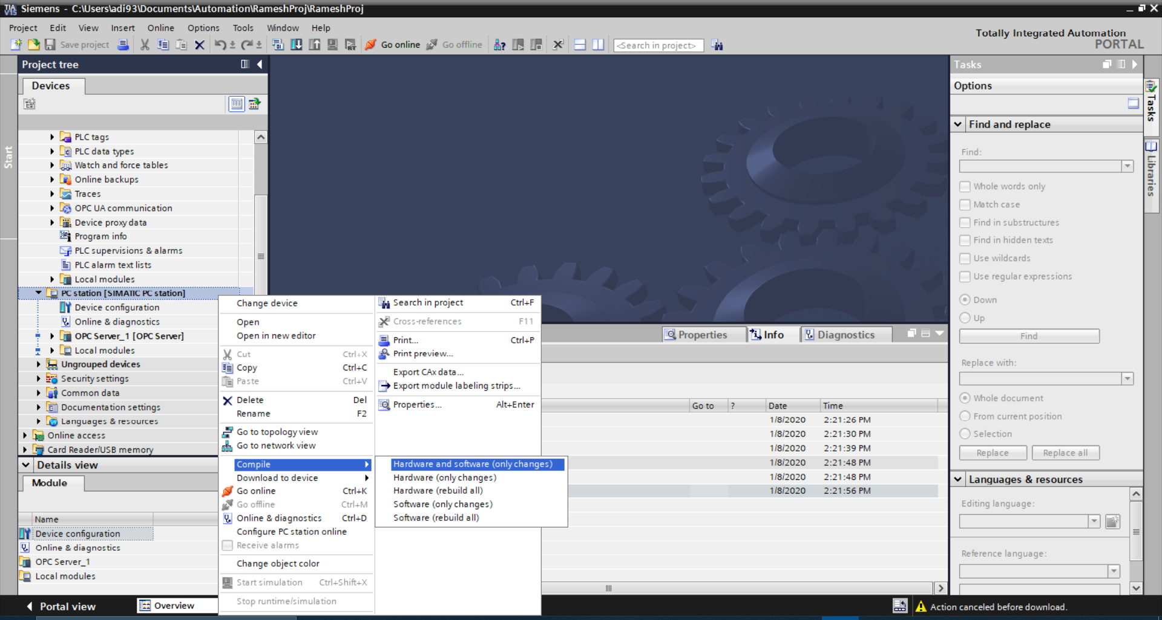
After Downloading , compile the pc which should create the XDB at the location you have set earlier in configuration

Slide 19
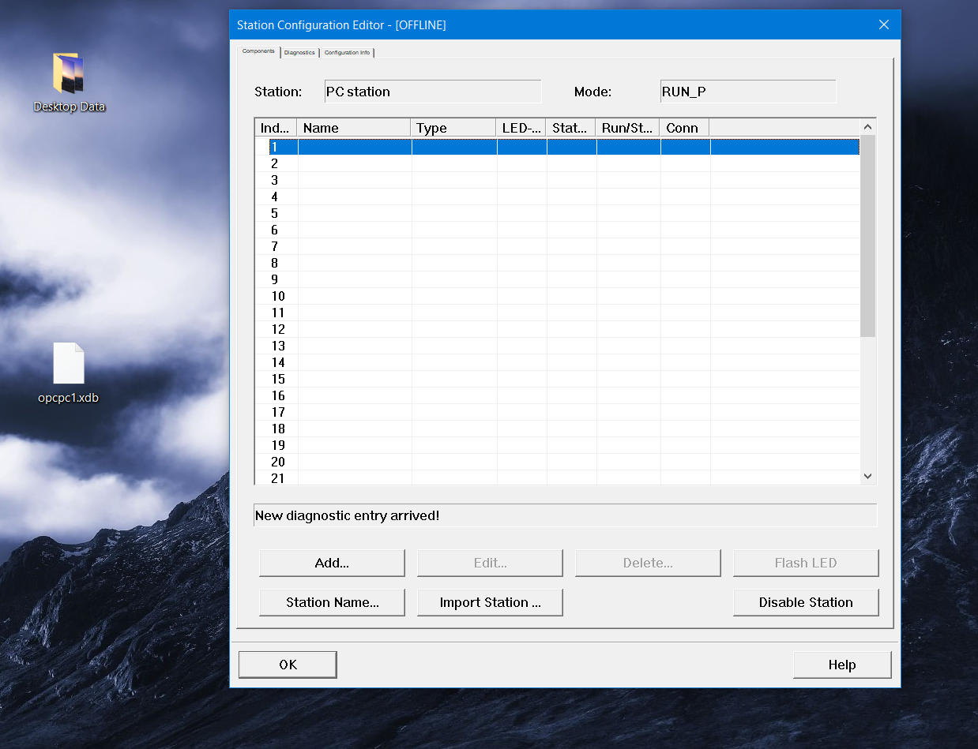
Once xdb file is generated, open station configurator program, the configurator program will be available after the installation of simatic net package. This application works as opc server and should be installed on pc which is intended to be server and the ip of the pc should be same as the one configured in OPC PC configuration of plc.

Slide 20
Use the import station option and select the xdb file

Slide 21
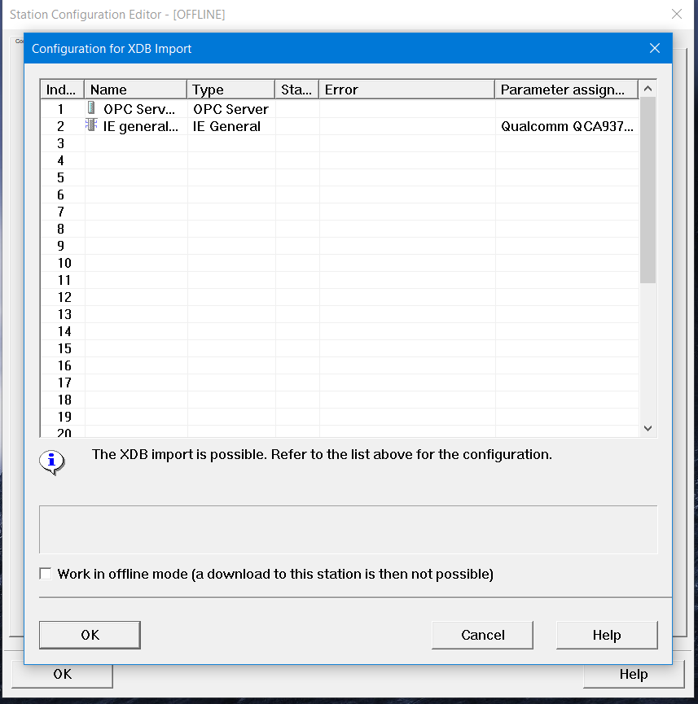
After selecting the XDB file, this windows should appear. Just select OK.

Slide 22
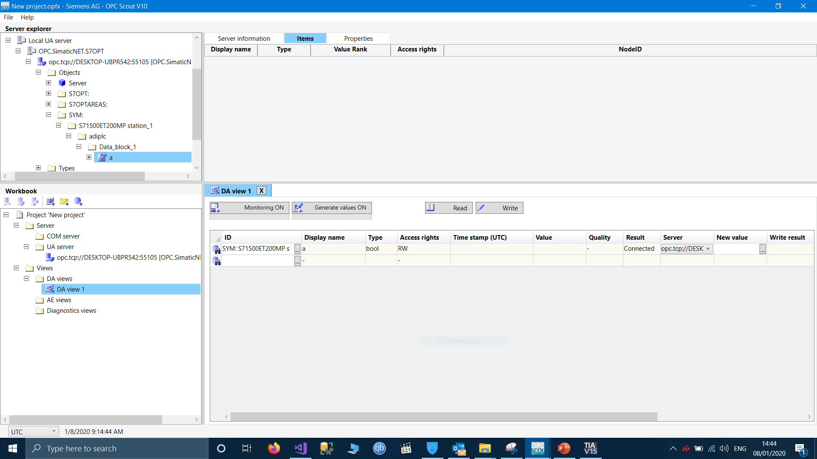
After configuration is done, open the OPC SCOUT application. On the left you should see the available opc servers and you can access the plc and DB and tags.
Drag and drop the tag into monitoring section
After adding tag, click monitor on, and the result should change to GOOD
Monitoring section

Slide 23
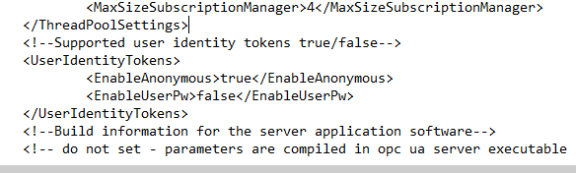
The opc configuration has been done for anonymous access,hence for opc scout the following changes needs to be done in a xml file located at : C:\ProgramData\Siemens\SIMATIC.NET\opc2\binS7opt\SCoreS7opt.xml
In case the Programdata folder is not visible, then file change visibility options to “show hidden files”
Set Enable anonymous to TRUE and EnableUserPw to False

Slide 24
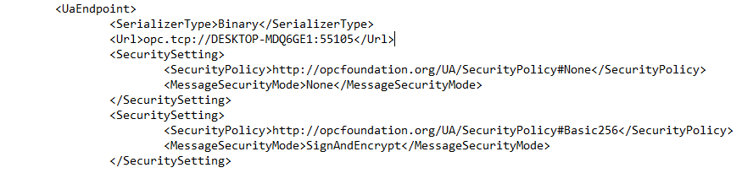
In the same xml file change the policy setting :
Set securityPolicy to #NONE
Remove the third <SecuritySetting>

